Slide 1

Presentation on STATISTICS

Slide 2

Definition of Statistics
Statistics is the study of the collection, analysis, interpretation, presentation, and organization of data.
It is a mathematical discipline to collect and summarize data.
Statistics is a branch of applied mathematics.

Slide 3
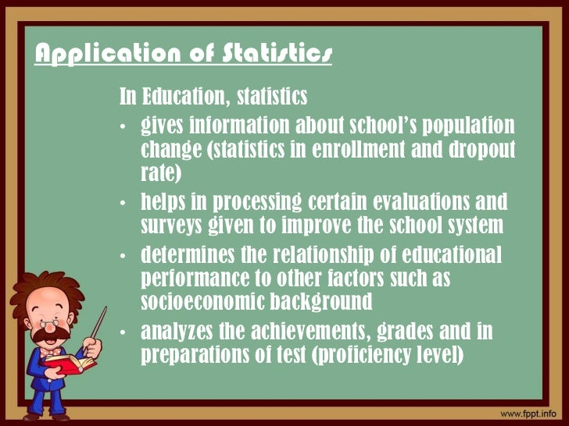

Slide 4
Type of Statistics
STATISTICS
Univariate
Bivariate
Multivariate
Inferential statistics
Hypothesis testing
Model fitting
Descriptive Statistics

Slide 5
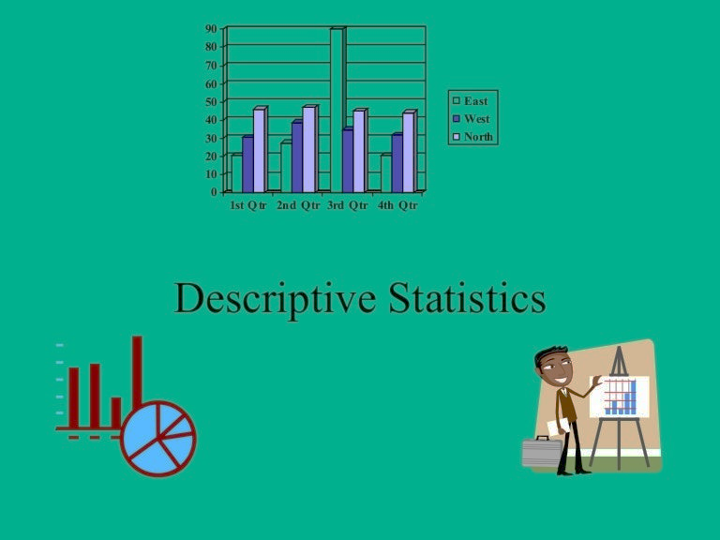
Descriptive statistics
Descriptive statistic is the summarized features of the given data.
Descriptive statistics is the process of using and analyzing the statistic.
Create an overview of the entire data set by summarizing it
Generate an actionable set of information from the large data set having multiple variables
Segregate the data into homogeneous groups to enable comparison
Provide basic information about variables in a dataset

Slide 6
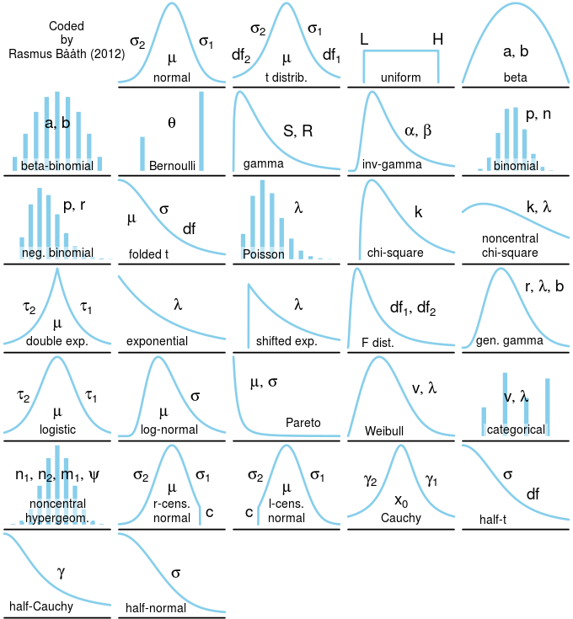
Univariate analysis
univariate analysis involves describing the distribution of a single variable, including its central tendency and dispersion.
The shape of the distribution may also be described using indices such as skewness and kurtosis.
This Photo by Unknown Author is licensed under CC BY-NC

Slide 7
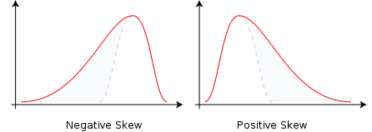
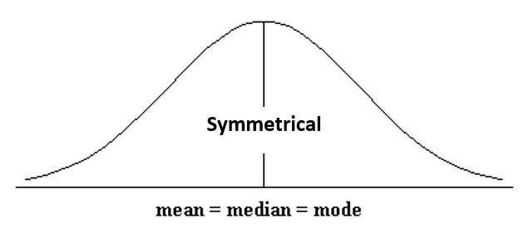
Skewness
In statistics, skewness is a measure of the asymmetry of the probability distribution of a real-valued random variable about its mean.
The skewness value can be positive, zero, negative, or undefined.
Skewness is measured by comparing the relative position of mean , median and mode.
Skewness is useful in measuring people’s income ,house prices , etc.
This Photo by Unknown Author is licensed under CC BY-NC
This Photo by Unknown Author is licensed under CC BY-NC

Slide 8
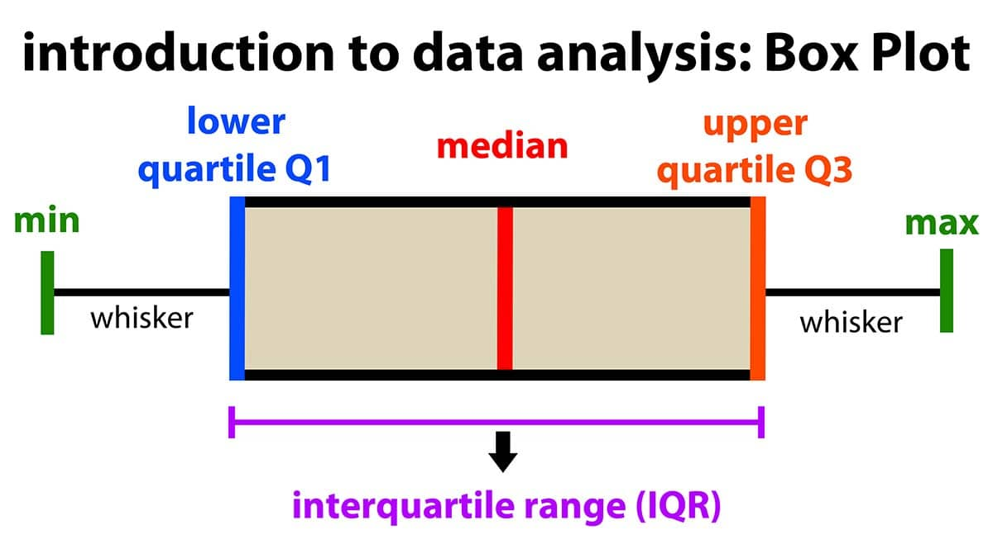
Box whisker plots
In descriptive statistics, box whisker plot is a method for graphically demonstrating the locality, spread and skewness groups of numerical data through their quartiles.
In addition to the box on a box whisker plot, there can be lines called whiskers extending from the box indicating variability outside the upper and lower quartiles,
Thus, the plot is also called the box-and-whisker plot and the box-and-whisker diagram.
This Photo by Unknown Author is licensed under CC BY-SA

Slide 9
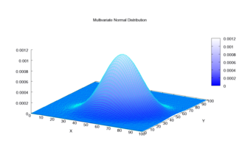
Bivariate and multivariate analysis
When a sample consists of more than one variable, then Bivariate and Multivariate analysis can be used.
These analysis describes the relationship between different variables.
In this case, descriptive statistics include:
Cross-tabulations and contingency tables
Graphical representation via scatterplots
Quantitative measures of dependence
Descriptions of conditional distributions
This Photo by Unknown Author is licensed under CC BY-SA

Slide 10
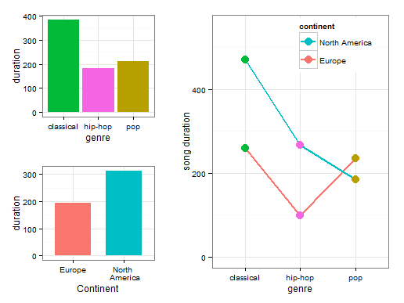
Inferential statistics
inferential statistics help us to make conclusions and predictions based on the data.
When certain data is collected from a sample, then inferential statistics is used to understand the larger population from which the sample is taken.
Inferential statistics have two main uses:
making estimates about populations
testing hypotheses to draw conclusions about populations
This Photo by Unknown Author is licensed under CC BY-NC

Slide 11
THANK
YOU
PRESENTATION BY:
C.SHIVANI
ROLL NO:23071A6712

